Slide 1




GUVI - Naan Mudhalvan
Engineering Hackathon 2025
1
www.guvi.in
Notes:
‹#›

Slide 2
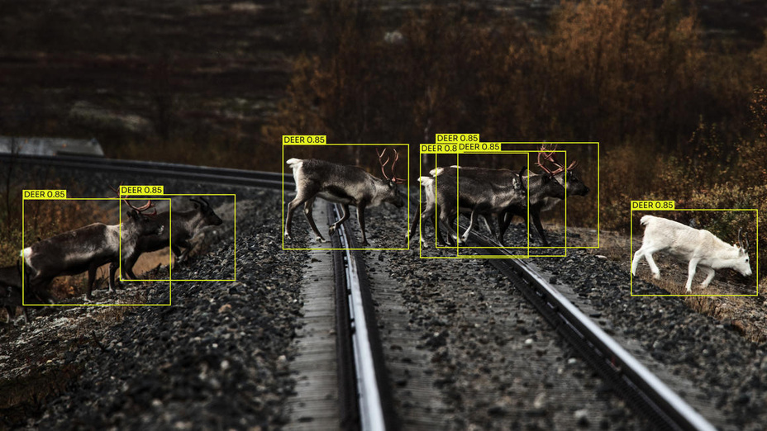
“Wildlife Monitoring System
Using Camera Traps”
Learning Programs
2
www.guvi.in

Slide 3
problem statement
Learning Programs
Conservationists need faster ways to analyze camera trap footage, often cluttered with environmental noise, varying animal poses, and partial occlusions. Manual review is slow and error-prone. An AI-based vision system must automatically Identify animal species and behavior from camera trap images to assist conservation
www.guvi.in

Slide 4
introduction
Learning Programs
The objective of this project is to develop an AI-based camera trap monitoring system that can automatically detect, identify, and classify wildlife species from images, reducing manual effort and improving the accuracy and speed of wildlife monitoring for conservation purposes.
4
www.guvi.in

Slide 5
Identifying the issues
Learning Programs
Manual review of camera trap data is slow and resource-intensive.
Environmental noise and clutter reduce detection accuracy.
Variations in animal poses and occlusions hinder species recognition.
Frequent misidentification due to complex, unstructured data.
Absence of automated behavior analysis in current monitoring methods.
5
www.guvi.in

Slide 6
Pre-existing Systems
Manual review of camera trap images.
Basic motion detection tools.
Limited species identification.
Demerits
Slow & labor-intensive.
Prone to human error.
Affected by background noise.
Poor accuracy with occlusions.
Not scalable for large data.
Learning Programs
6
www.guvi.in

Slide 7
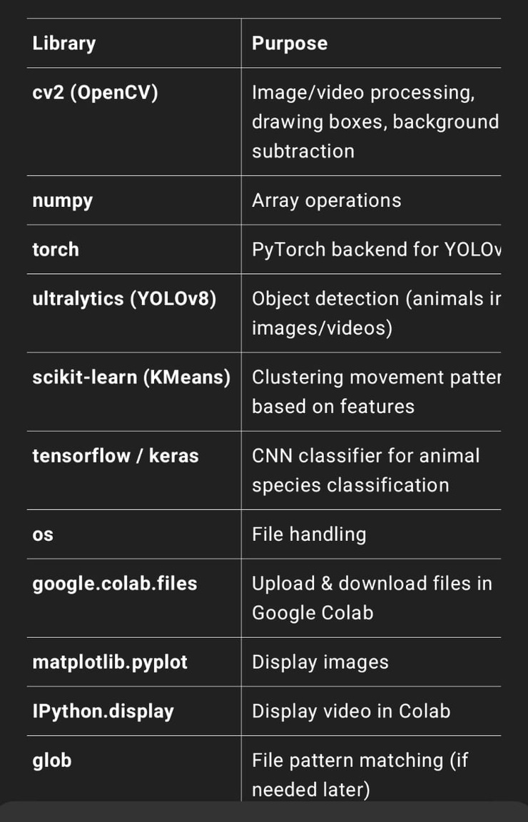
Learning Programs
libraries
used
7
www.guvi.in

Slide 8
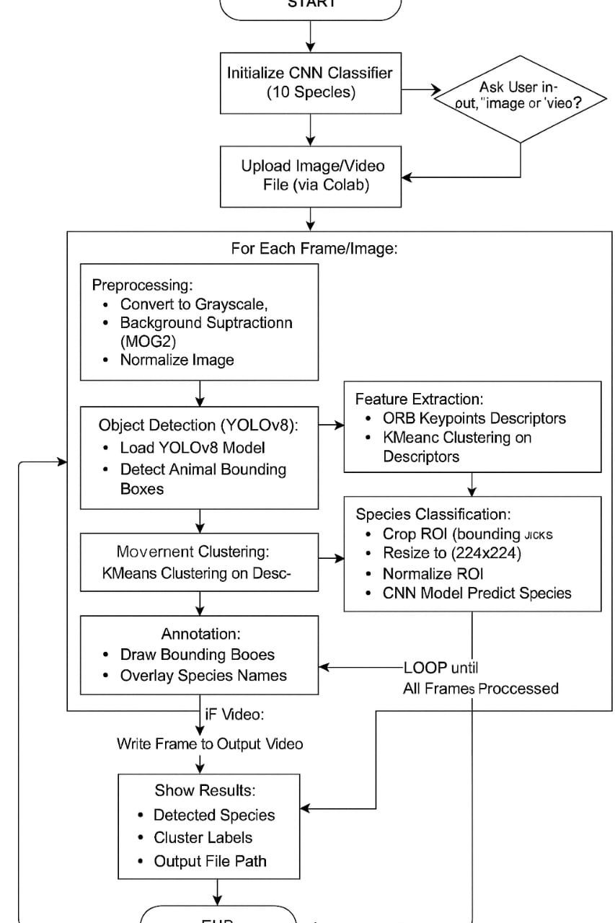
Learning Programs
flowchart
8
www.guvi.in

Slide 9
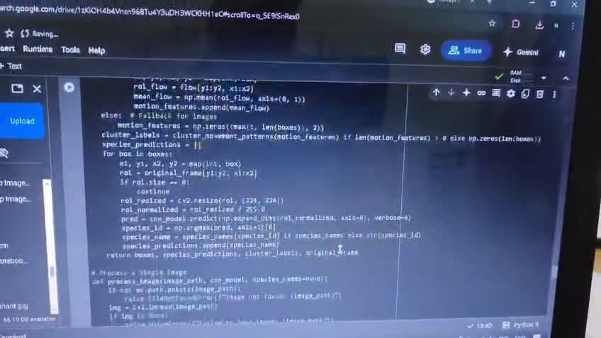
Learning Programs
9
www.guvi.in

Slide 10
Thank You
10
www.guvi.in
Notes:
‹#›

